Slide 1

Blue Dart Real-Time Delivery Process Improvement System - Sneha Shivanna

Slide 2
Why did I choose this project?
Imagine eagerly waiting for your package, tracking it day by day, only for it to get stuck at the last mile. That's exactly what happened to me! Since I’m in the US, my old contact number in India was assigned to my Blue Dart delivery, and I had no way to update it on time. Calls were missed, delivery attempts failed, and frustration grew.
I reached out to customer support, tried updating details through the sender, and even attempted some back-and-forth workarounds—but nothing worked. The result? Delays, uncertainty, and a lot of unnecessary stress.
This got me thinking... Why is last-mile communication still so broken? In a world of instant connectivity, delivery services should not just move packages but ensure a seamless, human-centered experience.

Slide 3
Introduction
As e-commerce and logistics services continue to grow, the need for efficient and reliable customer support has become crucial. Many logistics companies, including Blue Dart, have adopted AI-powered chatbots to assist customers with tracking shipments, resolving queries, and providing general support. However, the current chatbot faces several challenges, including slow response times, inaccurate information, and limited ability to handle complex queries.
The goal of this project is to enhance the chatbot's functionality by improving its AI capabilities while integrating a live agent support system. This hybrid approach ensures that when the chatbot is unable to resolve an issue, a human agent steps in to assist the customer seamlessly. By optimizing AI-driven automation and implementing a smart escalation system, this project aims to enhance the overall user experience, reduce call center workload, and improve customer satisfaction.

Slide 4
Problem Statement
The current Blue Dart-developed chatbot struggles with response accuracy, slow performance, and poor user experience, often leading to customer frustration. Users frequently encounter incorrect tracking information, slow responses, and an inability to handle complex queries, which results in increased call center workload and low chatbot adoption. Additionally, there is no proper escalation to live agents, causing further dissatisfaction when the bot fails. While engineering teams work on improving AI capabilities, there is an immediate need to integrate live agent intervention to ensure seamless customer support.

Slide 5
Market Research and Analysis
Industry Trends
The global AI chatbot market is experiencing rapid growth, with increasing adoption in logistics and customer service. According to industry reports, the chatbot market is expected to reach $10 billion by 2025, driven by the need for cost-effective and scalable customer support solutions (MarketsandMarkets, 2023).
Customer Expectations
A survey conducted among logistics customers highlights key areas for improvement:
63% of users reported frustration due to incorrect tracking information (Statista, 2023).
45% of chatbot interactions escalate to human agents, indicating bot inefficiency (Zendesk, 2023).
30% of users experience slow response times, leading to increased reliance on customer support calls (Salesforce, 2023).
Competitive Analysis
Company | Chatbot Strengths | Weaknesses
DHL | Multi-channel support, real-time tracking updates | Lacks proactive customer assistance (Forrester, 2023)
UPS | AI-driven smart recommendations, seamless API integration | Limited NLP understanding in complex queries (McKinsey, 2023)
FedEx | Voice-enabled AI bot, strong mobile integration | UI complexity in some interactions (PwC, 2023)
Amazon Logistics | Predictive delivery updates, automated issue resolution | Not available for all users (CB Insights, 2023)

Slide 6
Product Strategy
Vision Statement
To develop an intelligent, efficient, and user-friendly AI chatbot that provides seamless real-time logistics support by combining AI-driven automation and live agent intervention, ensuring a frictionless customer experience, and reduced operational costs for Blue Dart.
Product Goal
Enhance AI chatbot intelligence to improve query handling.
Implement a seamless live agent handoff for bot failures.
Reduce operational costs by optimizing the AI-human support system.
Provide multi-channel accessibility through the website, WhatsApp, SMS, and email.
Continuously improve AI with feedback-driven learning.
Business Objectives and Key Results (OKRs)
Business Objective | Key Result (KR)
Increase chatbot efficiency | Reduce bot failure rate.
Improve customer satisfaction | Increase CSAT score from 3.5 to 4.5 out of 5
Optimize call center operations | Reduce call center queries.
Enhance response time | Reduce live agent response time from 2-5 minutes to less than 1 minute
Scale bot adoption | Increase chatbot interaction adoption

Slide 7
Key Challenges and Solutions
Challenge | Proposed Solution
Bot fails to understand complex queries | Improve NLP model by training on real customer conversations
Users get frustrated when bot does not provide answers | Implement live agent escalation for unresolved queries
Slow response time for bot and live agent | Optimize backend API calls and response caching
Low chatbot adoption | Deploy multi-channel support through WhatsApp, SMS, and email to increase accessibility
Poor AI learning mechanism | Implement feedback loops so AI continuously learns from past conversations

Slide 8
Core Product Features and Enhancements
AI Chatbot Enhancements
Implement GPT-based NLP models for better context understanding.
Enable chatbot memory to recall past interactions.
Optimize API performance for real-time tracking updates.
Live Agent Handoff System
If AI confidence is below 80%, the bot will offer live agent support.
The chatbot will suggest responses to agents for efficiency.
Multi-Channel Deployment
Enable bot access through WhatsApp, SMS, and email.
Ensure a seamless experience across platforms, including website and mobile integration.

Slide 9
Key Metrics and KPIs for Success
Metric | Current State | Target
Bot Failure Rate | 45% | Less than 20%
Escalation to Human Agents | 40% | 15%
Live Agent Response Time | 2-5 minutes | Less than 1 minute
Customer Satisfaction (CSAT) | 3.5 out of 5 | 4.5 out of 5
Expected Business Impact
Increased customer trust by ensuring users are not stuck with an unhelpful bot.
Improved operational efficiency by allowing AI to handle simple queries while agents focus on complex issues.
Data-driven AI enhancements by leveraging live agent interventions to improve the chatbot.
Higher adoption rates due to a seamless escalation process ensuring users feel supported.

Slide 10
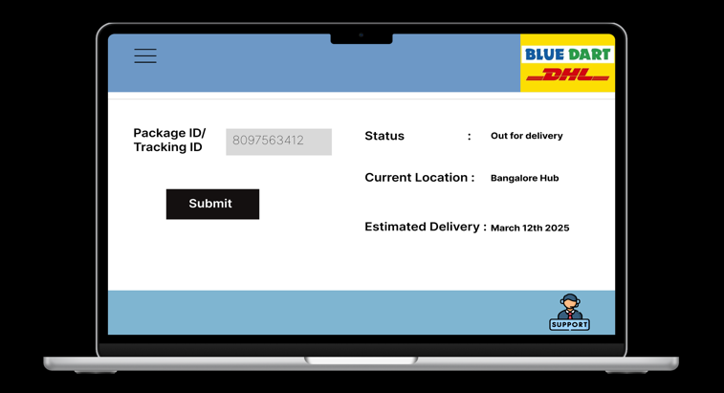
User Experience and Wireframe

Slide 11
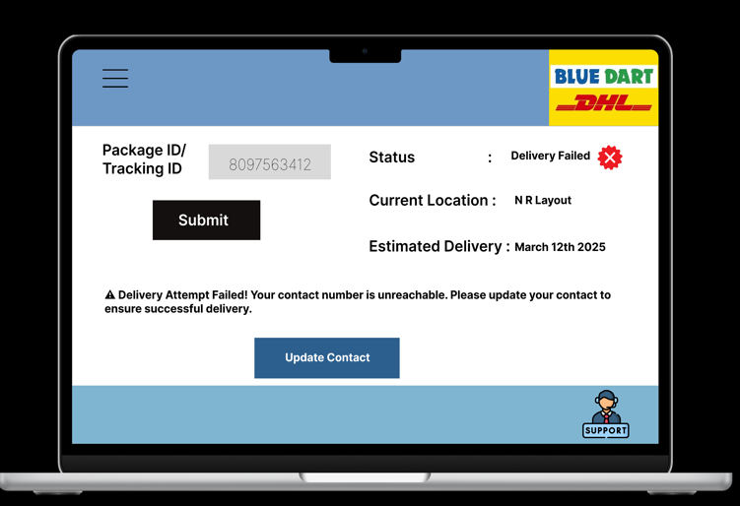

Slide 12
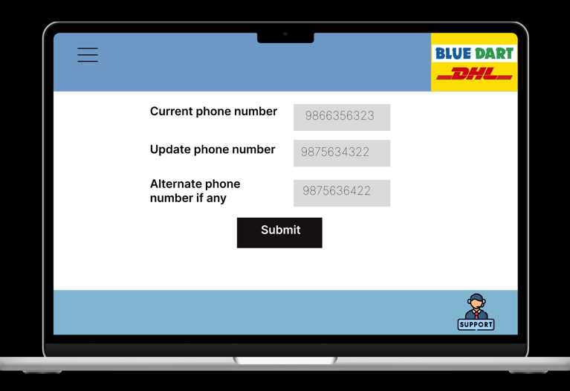

Slide 13
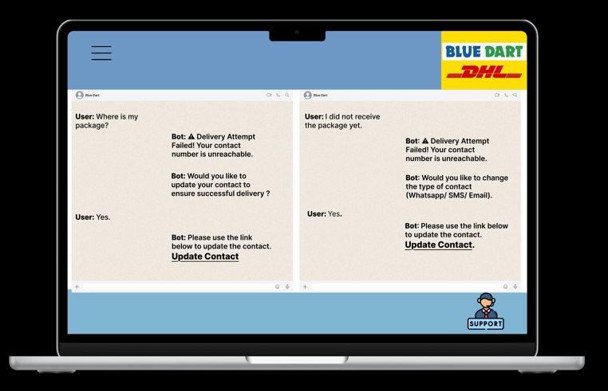

Slide 14
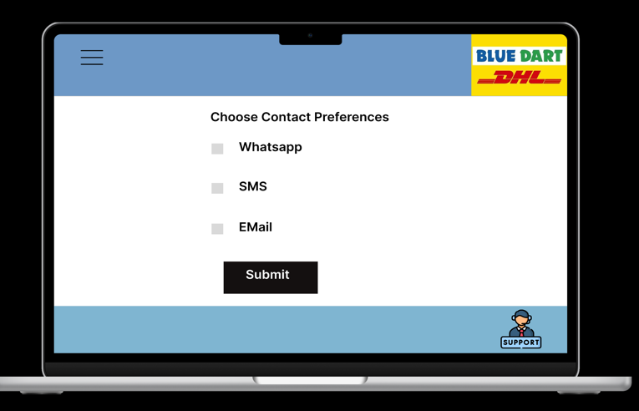

Slide 15
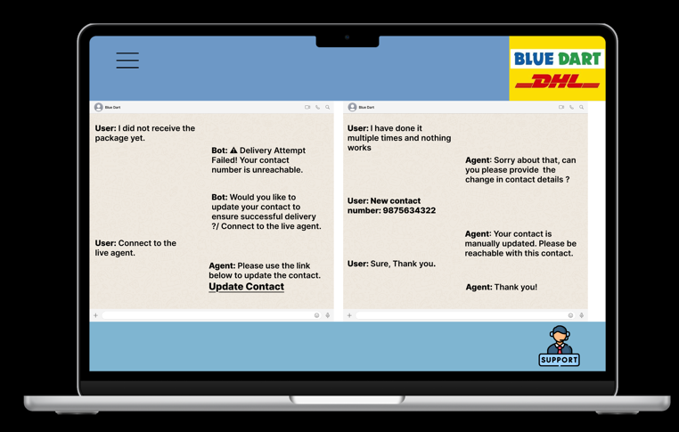

Slide 16
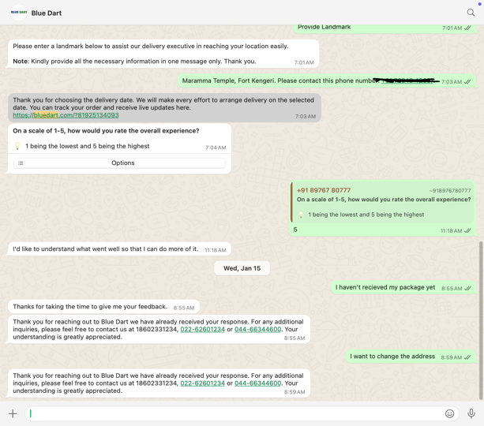

Slide 17
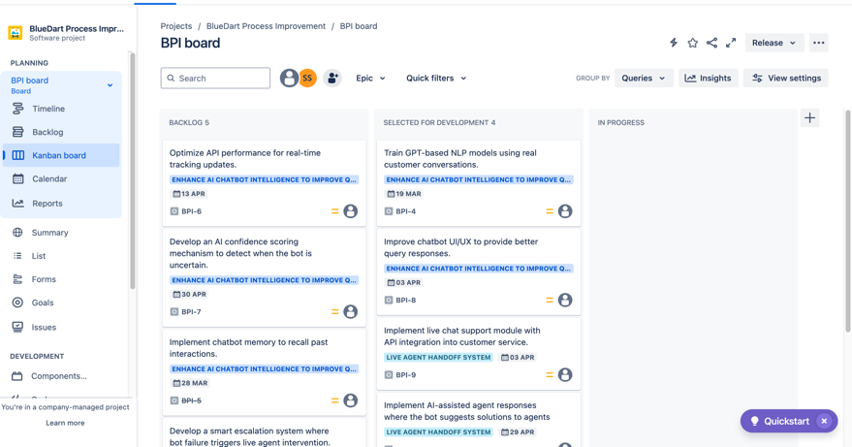
Product Roadmap

Slide 18
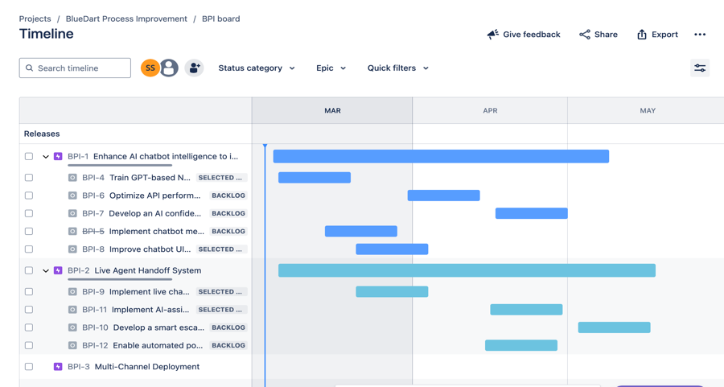

Slide 19
Conclusion
By taking a structured product management approach, we can revamp the chatbot experience, making it faster, smarter, and more user-friendly while aligning with Blue Dart’s business goals.
This strategy will not only improve chatbot efficiency and reduce support costs but also enhance customer engagement by providing real-time resolutions.
The integration of live agent support ensures that no customer query remains unresolved, leading to increased satisfaction and trust.
By continuously refining AI capabilities and optimizing human intervention, Blue Dart will establish itself as a leader in AI-powered logistics support, delivering superior service in a competitive market.

Slide 20
References
MarketsandMarkets. (2023). AI Chatbots Market Report 2023. Retrieved from https://www.marketsandmarkets.com
Gartner. (2023). AI in Customer Support: The Next Evolution. Retrieved from https://www.gartner.com
Forrester. (2023). AI in Logistics and Customer Service. Retrieved from https://www.forrester.com
McKinsey. (2023). The State of AI in Customer Experience. Retrieved from https://www.mckinsey.com
PwC. (2023). AI and Digital Transformation in Logistics. Retrieved from https://www.pwc.com
CB Insights. (2023). AI Trends in E-commerce and Logistics. Retrieved from https://www.cbinsights.com
Statista. (2023). Customer Experience Trends in Logistics. Retrieved from https://www.statista.com
Zendesk. (2023). Customer Support Trends Report. Retrieved from https://www.zendesk.com
Salesforce. (2023). State of Service Report. Retrieved from https://www.salesforce.com
Accenture. (2023). AI-Driven Customer Experience. Retrieved from https://www.accenture.com
Figma Link: https://www.figma.com/proto/HfVbu1iDJWLIDf56Gbddoz/BD-Wireframe?node-id=15-163&p=f&t=sY77f6yhWjYmOISs-0&scaling=scale-down&content-scaling=fixed&page-id=0%3A1
Product Roadmap: https://sshivannasneha.atlassian.net/jira/software/c/projects/BPI/boards

Slide 21
Thanks!

